Slide 1

Bo Liu Guanyu Zhu Jinran Tian Tasleem Rayali
Sunset-Love
Fall2020 Project Team 6 1

Slide 2

Review
Lack of a well-developed elder matchmaking
database
Single Elders living with family
Elders live alone
Lack of a comfortable way to find candidates for parents as children
Elders unfamiliarity with modern applications
Elders' children who are looking for a relationship for their parent
Fall2020 Project Team 6 2

Slide 3


Proposed Solution
 | Sunset Love | Happy Life (Traditional agency) | Peach Blossom (Dating TV show) | Jiayuan.com | Match.com | OurTime
Free Tier
User age range >60 y/o
Available in China
Professional Service
Voice Assistance
Child Parent profile link
Fall2020 Project Team 6 3
Notes:
Current solutions include Traditional Match making agencies, local dating TV shows, dating applications and Dating applications specific to elders over 50 years.
Traditional matchmaking agencies are very expensive but are trusted by elders and some applications don't provide a free tier for users to explore the application before using it. Jiayuan.com and Match.com are not specific to elders and don't not cater their needs and interests
Our time is specific to elders over 50 y/o but is limited to United States and Canada
Only the traditional agencies and dating shows provide professional services
The current applications are not easy to use for elders who are not well versed with technology
There are no features available for children to search partners for their parents
Sunset Love overcomes these limitations by providing a digital, easy to use, affordable and safe solution to elderly over 60 years old to find emotional partners.
Ill pass on to Terry to show our visual story board

Slide 4
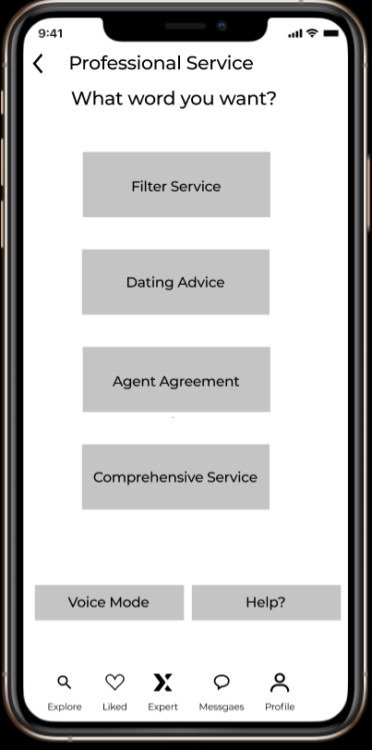
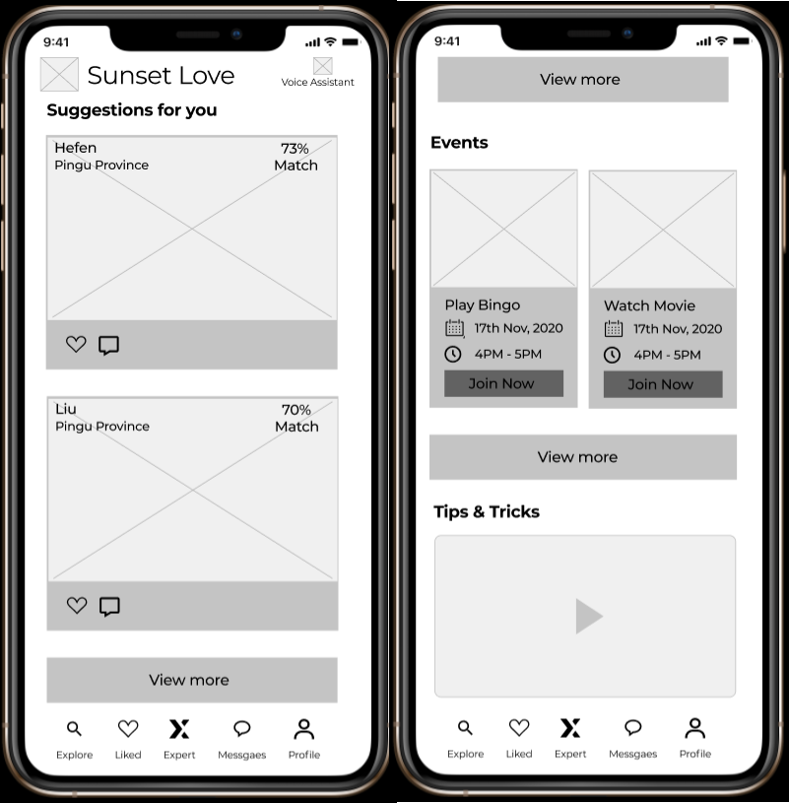
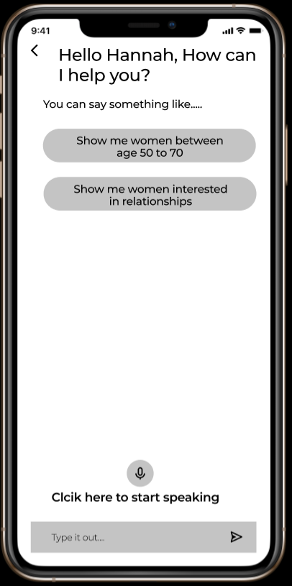
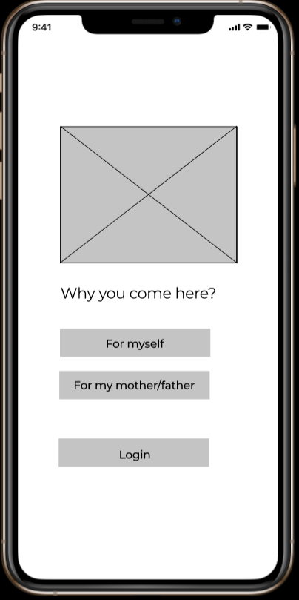
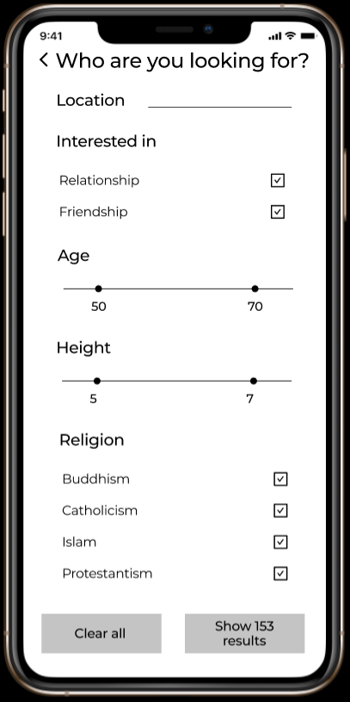
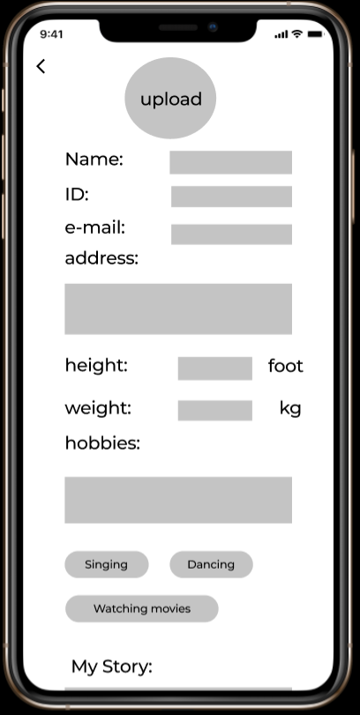
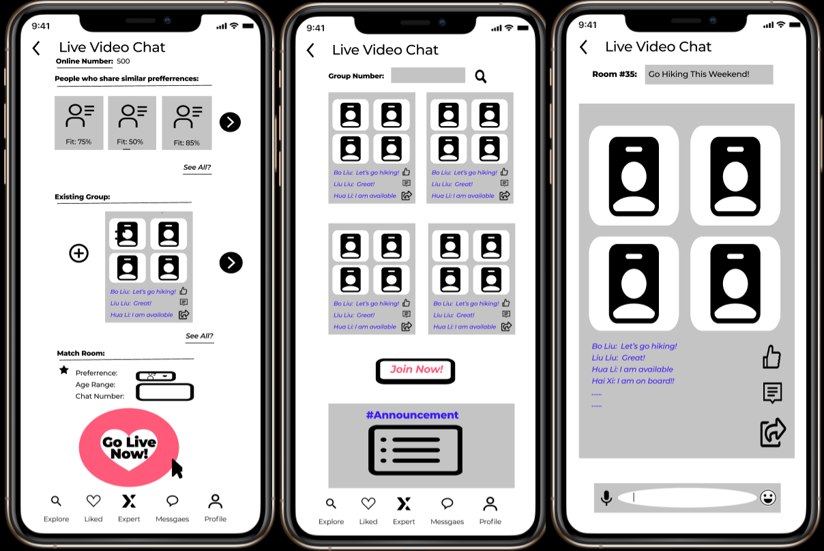
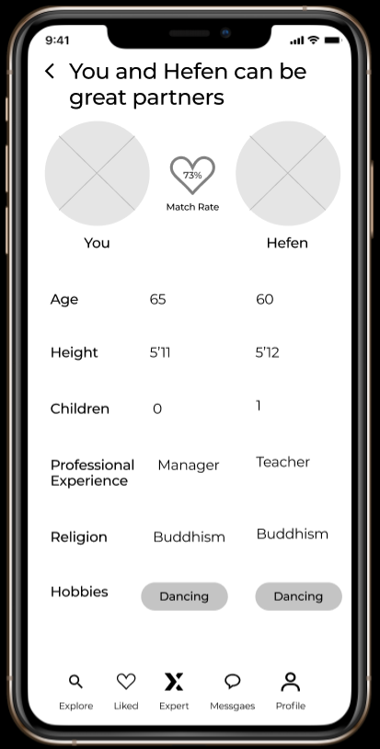
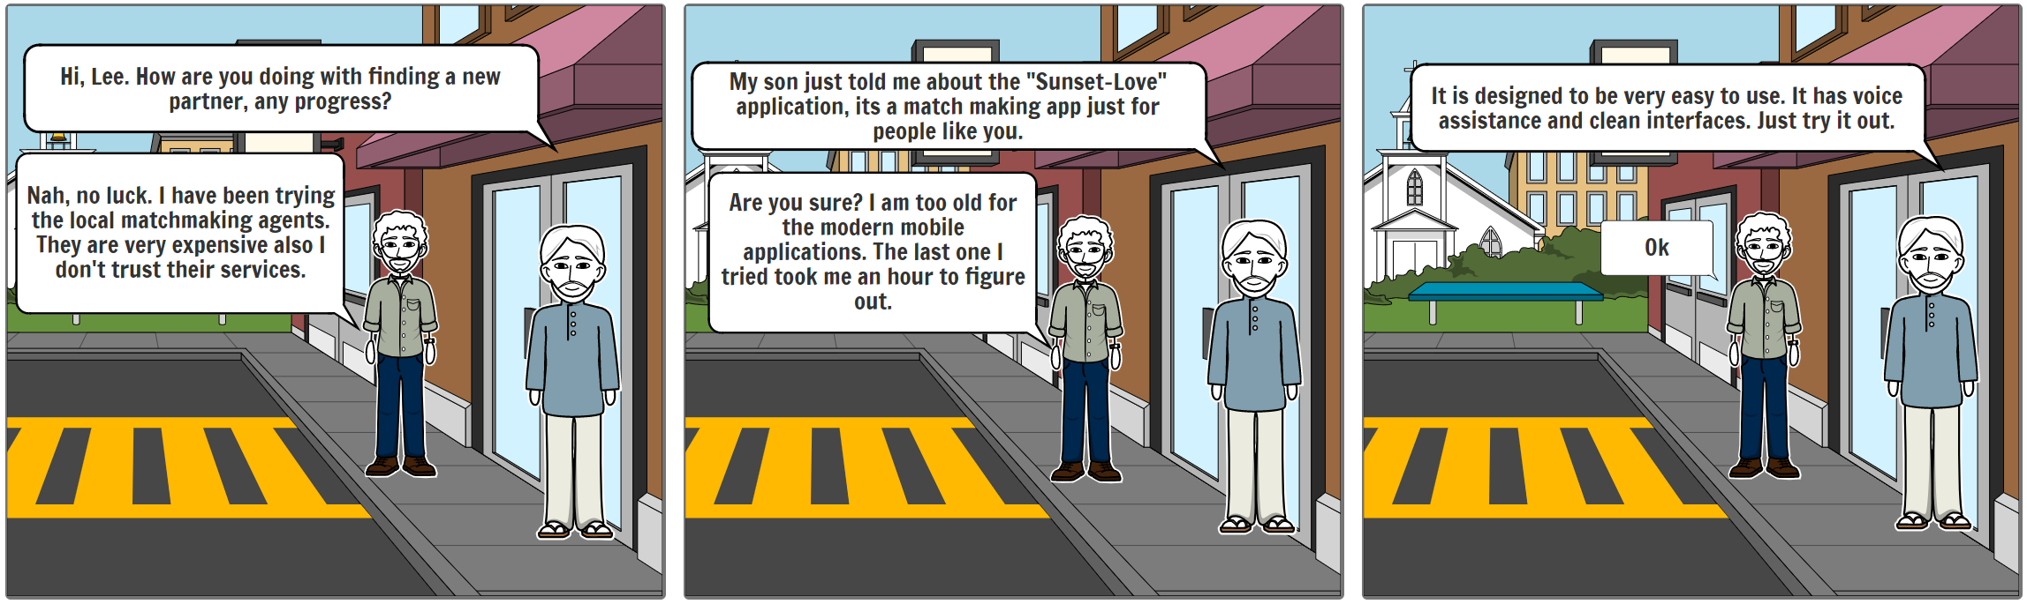
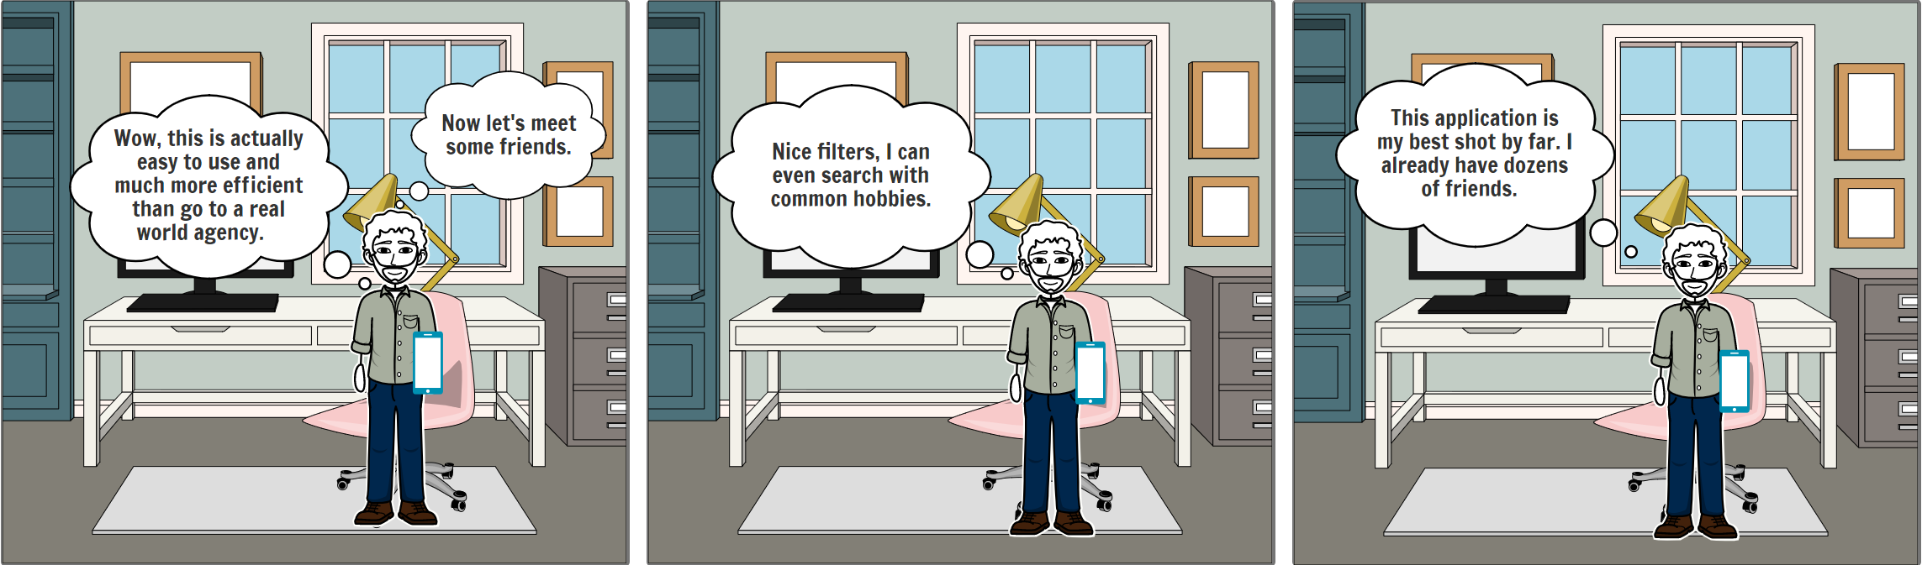
Visual Storyboard
Fall2020 Project Team 6 4

Slide 5
Product Roadmap
Quarter 1
Jan to March
Quarter 2
April-May
Quarter 3
June
Full launch on Aug 25 on Chinese Valentines day
Quarter 4
July-Aug
Fix bugs, analyze metrics
Alpha launch Internal test of MVP
Beta launch: for selected elders and children
Fall2020 Project Team 6 5
Notes:
We plan to do alpha launch by the end of March. Tests would be conducted internally within our team for our MVP Team would be responsible noting bugs and creating specific tasks to fix those bugs.
Next we plan to do our Beta launch with selected elders and children, we plan to tie up with matchmaking agencies to encourage their customers to sign up for our app. Matchmaking agencies will get an opportunity to offer professional services via our app and increase their customer reach.
Next we plan to fix issues , analyze metrics and work on user feedback to increase our conversions.
Finally we plan to launch our application on August 25 on Chinese valentines day during an event in a park in Beijing.
Many elders go to parks, to find partners and some parks have dedicated matchmaking corners, so we'll be able to cater huge audience.
Next I pass on to Bobby to introduce our product features

Slide 6













Product Features
User Registration
Profile Management
Home Dashboard
Customized Suggestion
Ideal Partner Search
Compatibility Analysis
Premium Membership
Professional Service
Event Calendar
Dating Arrangement
Message Inbox
Live Chat Dashboard
Voice Assistance
Fall2020 Project Team 6 6

Slide 7







Features of MVP for Launch
Single Elder
Elder Registration
and Profile
Search
Filter
Dating
Arrangement
Matchmaking
Suggestion
Voice
Assistance
Children
Children Registration
and Profile
Linked
Profile with Parent
Fall2020 Project Team 6 7

Slide 8



Key Metrics
Number of people who found their emotional partners
Number of dates arranged
Number of children profiles linked to parent’s profile
Fall2020 Project Team 6 8
Notes:
Our northstar metric is the number of people who have found their emotional partners. Dependent metrics for calculation are Number of dates arranged and
conversations that turned into dates and the dates arranged by dating experts and eventually if they have accepted their partners.
Our next key metric is Number of childrens profiles linked to parents profile with this we’ll come to know children are actually able to find partners for their parent which eventually turn to dates
Additional metrics
Number of user downloads
Number of unique visits per day
Average time spent by users per day
Number of messages sent/received per day
Number of people subscribing to premium membership
Number of people opting for professional services
Ill pass on to Garry to talk about operational costs

Slide 9
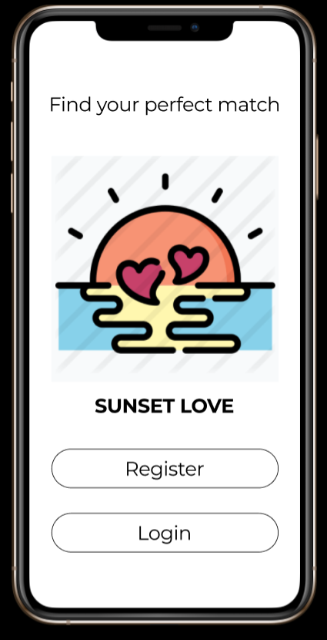
Operational Needs
Law Firm and Accounting firm
China Civil Affairs Bureau
Remote video call technical team
Marriage Agency
“Alibaba Cloud” Cloud Service
WeChat/Alipay Corporate Online Payment Service Team
Fall2020 Project Team 6 9

Slide 10
Project Costs
Item | Detail | Month(people) (RMB to USD) | Total(year/people) (RMB to USD)
Development machine | Alibaba Cloud ecs. g6 server (general edition) | 587.81 | 7053.72
 | Alibaba Cloud database (SQL edition) | 771.50 | 9,256.95
Management team | 1 Project manager | 4000 | 50,000(including Year-end awards)
 | 1 Product manager | 3,500 | 45,000(same)
 | 2 product operators | 29,00 | 36,000(same)
Engineering team | 8 Front-end developers | 3,000 | 38,000(same)
 | 2 Back-end developers | 3,500 | 45,000(same)
Costs ≈46 thousand USD(month)≈ 0.6 million USD (year)
Fall2020 Project Team 6 10

Slide 11




Addressing Risks
Data Privacy Concerns
System Robustness Concerns
Operation Concerns
Competition & Partnership Concerns
Fall2020 Project Team 6 11

Slide 12
Thank You All for Listening!

